Slide 1
Clipping Algorithm
Computer Graphics

Slide 2
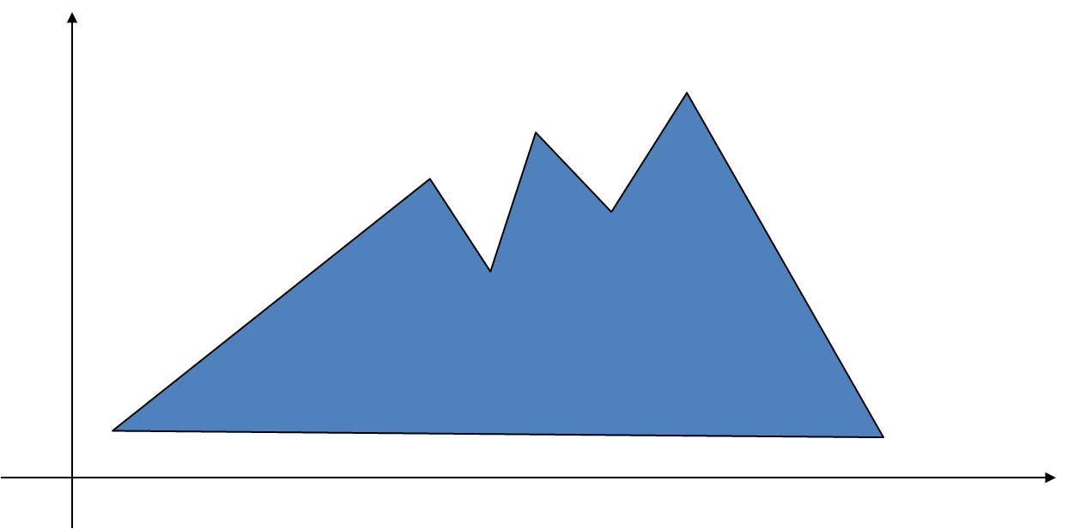
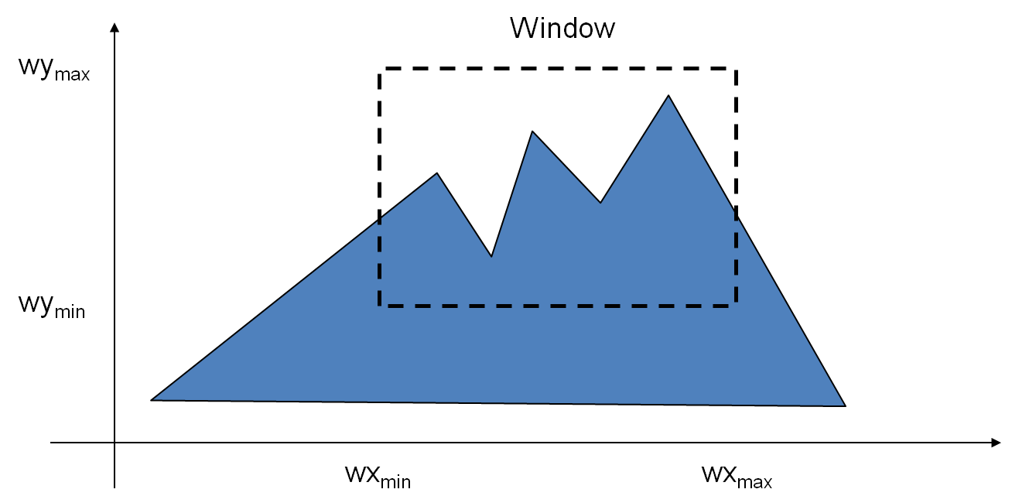
Introduction
When we have to display a large portion of the picture, then not only scaling & translation is necessary, the visible part of picture is also identified. This process is not easy. Certain parts of the image are inside, while others are partially inside. The elements which are partially visible will be omitted.

Slide 3
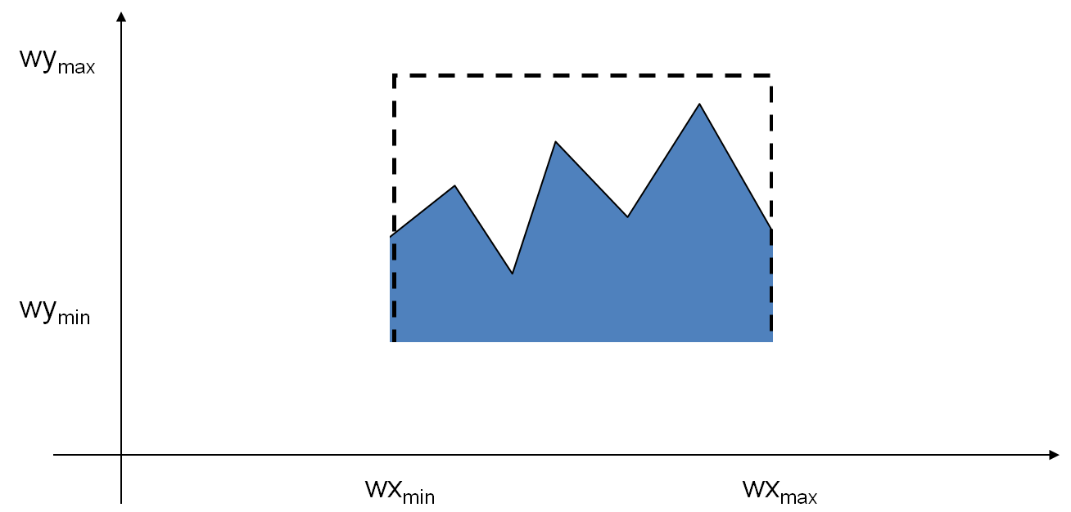
Introduction
For deciding the visible and invisible portion, a particular process called clipping is used.
Clipping determines each element into the visible and invisible portion. Visible portion is selected. An invisible portion is discarded.

Slide 4
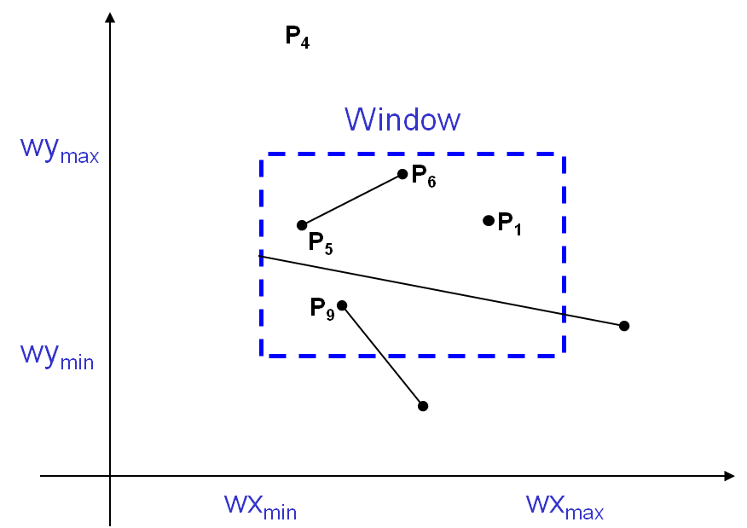

Introduction
For the image below consider which lines and points should be kept and which ones should be clipped

Slide 5
Types of Clipping
Point Clipping
Line Clipping
Area Clipping (Polygon)
Curve Clipping

Slide 6
Point Clipping
Point Clipping is used to determining, whether the point is inside the window or not. For this following conditions are checked.
Easy - a point (x,y) is not clipped if:
wx_{min} ≤ x ≤ wx_{max} AND wy_{min} ≤ y ≤ wy_{max}
otherwise it is clipped

Slide 7
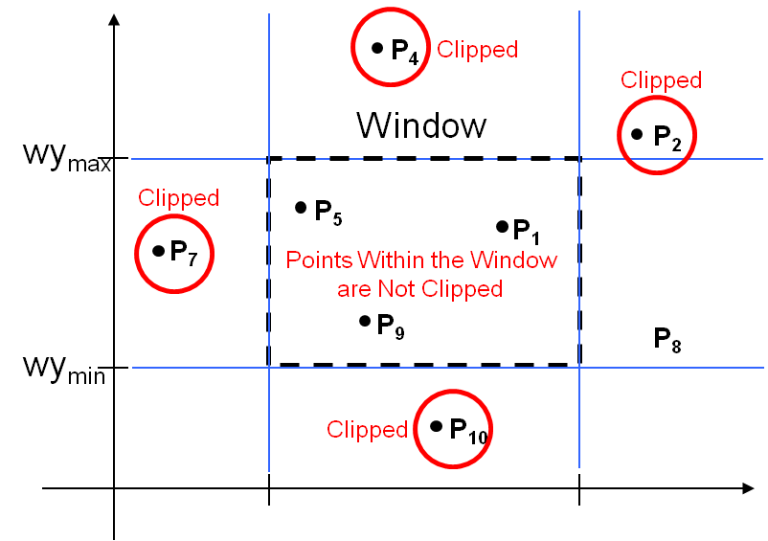

Point Clipping

Slide 8
Line Clipping
Lines are of three types:
Visible: A line or lines entirely inside the window is considered visible
Invisible: A line entirely outside the window is considered invisible
Clipped: A line partially inside the window and partially outside is clipped. For clipping point of intersection of a line with the window is determined.

Slide 9
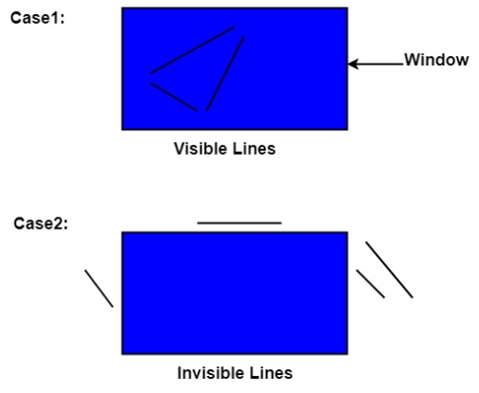
Line Clipping

Slide 10
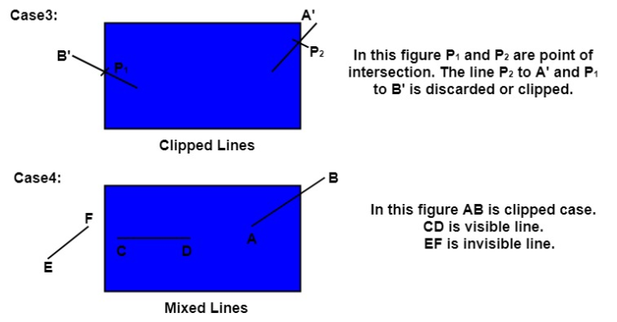
Line Clipping

Slide 11
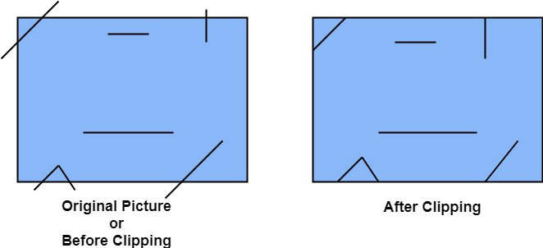
Line Clipping
Clipping can be applied through hardware as well as software. In some computers, hardware devices automatically do work of clipping. In a system where hardware clipping is not available software clipping applied.
Following figure show before and after clipping

Slide 12
Cohen-Sutherland Clipping Algorithm
In the algorithm, first of all, it is detected whether line lies inside the screen or it is outside the screen. All lines come under any one of the following categories:
Visible
Not Visible
Clipping Case

Slide 13
Cohen-Sutherland Clipping Algorithm
Visible: If a line lies within the window, i.e., both endpoints of the line lies within the window. A line is visible and will be displayed as it is.
Not Visible: If a line lies outside the window it will be invisible and rejected. Such lines will not display. If any one of the following inequalities is satisfied, then the line is considered invisible. Let A (x1,y2) and B (x2,y2) are endpoints of line.

Slide 14
Cohen-Sutherland Clipping Algorithm
Xmin,xmax and ymin,ymax are coordinates of the window.
x1>xmax
x2>xmax
y1>ymax
y2>ymax
x1<xmin
x2<xmin
y1<ymin
y2<ymin

Slide 15
Cohen-Sutherland Clipping Algorithm
3.Clipping Case: If the line is neither visible case nor invisible case. It is considered to be clipped case.
First of all, the category of a line is found based on nine regions.
All nine regions are assigned codes.
Each code is of 4 bits.
If both endpoints of the line have end bits zero, then the line is considered to be visible.

Slide 16
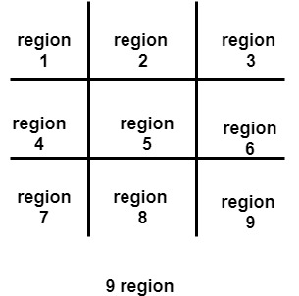
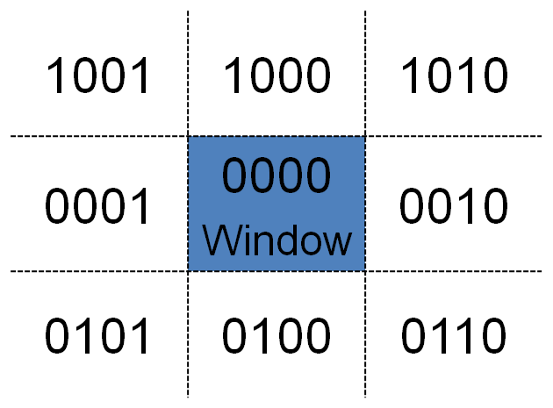
Cohen-Sutherland Clipping Algorithm

Slide 17
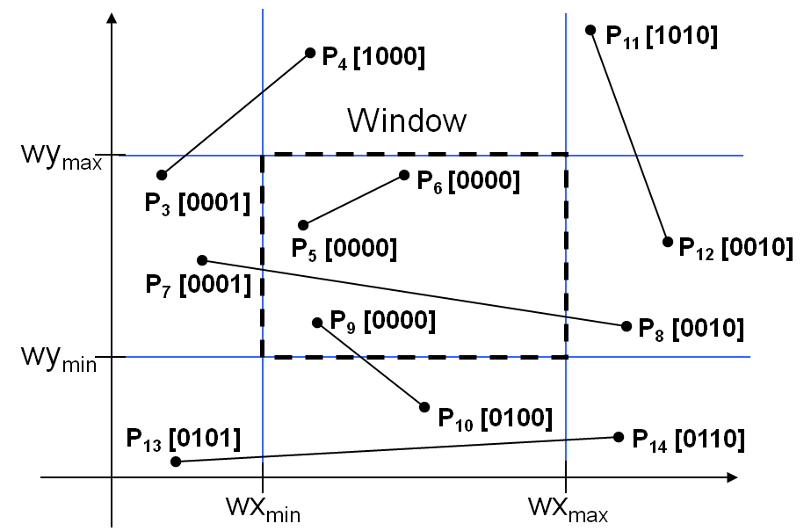
Cohen-Sutherland Clipping Algorithm
Step 1:Determine the bit values of the two end-points of the line to be clipped (which is similar to labelling every end-point with the appropriate region code)

Slide 18
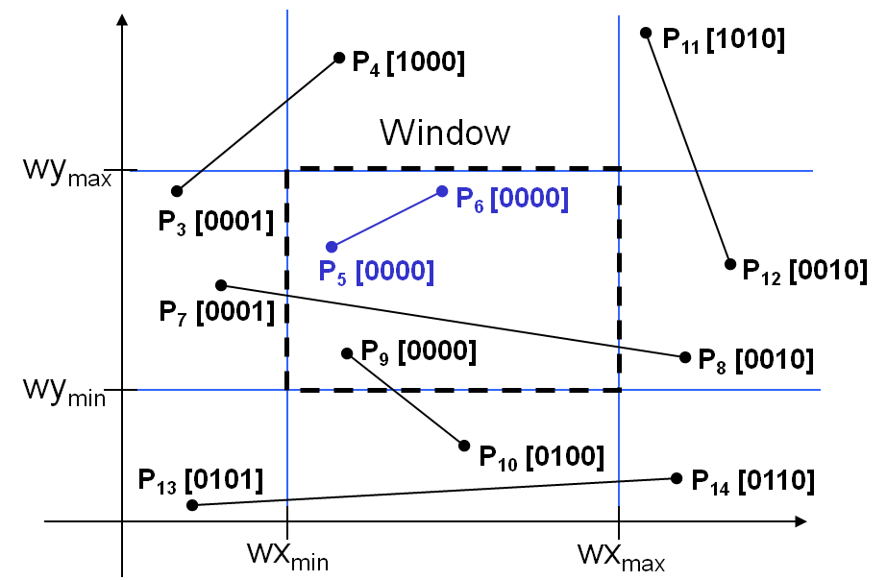
Cohen-Sutherland Clipping Algorithm
Don’t Clip: If both endpoint codes are [0000],then the line lies completely inside the window, no need to clip. This is the simplest case.

Slide 19
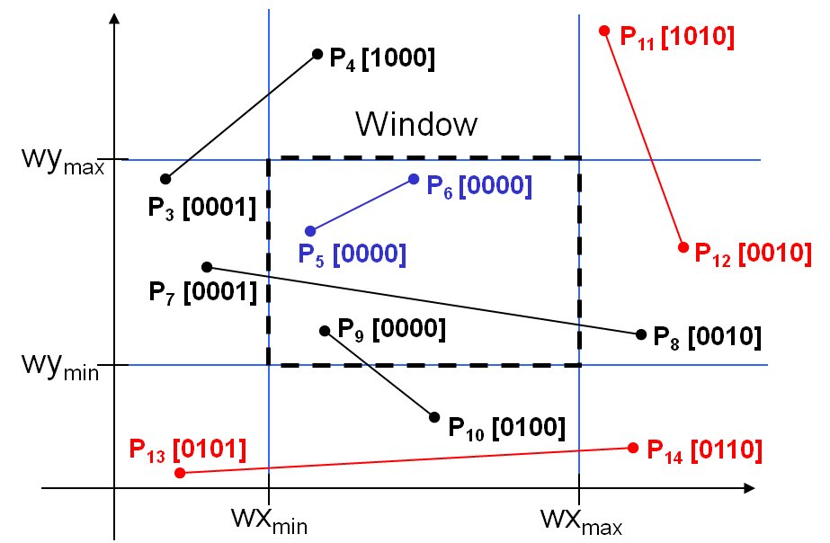
Cohen-Sutherland Clipping Algorithm
Reject: Any line that has 1 in the same bit position of both end points, is guaranteed to lie outside the window completely.
Test: Perform bitwise AND operation of the endpoint codes. If the result is not [0000], reject the line.

Slide 20
Cohen-Sutherland Clipping Algorithm
Reject: Any line that has 1 in the same bit position of both end points, is guaranteed to lie outside the window completely.
Test: Perform bitwise AND operation of the endpoint codes. If the result is not [0000], reject the line.

Slide 21
Cohen-Sutherland Clipping Algorithm
Once the codes for each endpoint of a line are determined, the logical AND operation of the codes determines if the line is completely outside of the window.
If the logical AND of the endpoint codes is not zero, the line can be trivially rejected. For example, if an endpoint had a code of 1001 while the other endpoint had a code of 1010, the logical AND would be 1000 which indicates the line segment lies outside of the window.
On the other hand, if the endpoints had codes of 1001 and 0110, the logical AND would be 0000, and the line could not be trivially rejected.

Slide 22
Cohen-Sutherland Clipping Algorithm
The logical OR of the endpoint codes determines if the line is completely inside the window. If the logical OR is zero, the line can be trivially accepted.
For example, if the endpoint codes are 0000 and 0000, the logical OR is 0000 - the line can be trivially accepted. If the endpoint codes are 0000 and 0110, the logical OR is 0110 and the line can not be trivially accepted.

Slide 23
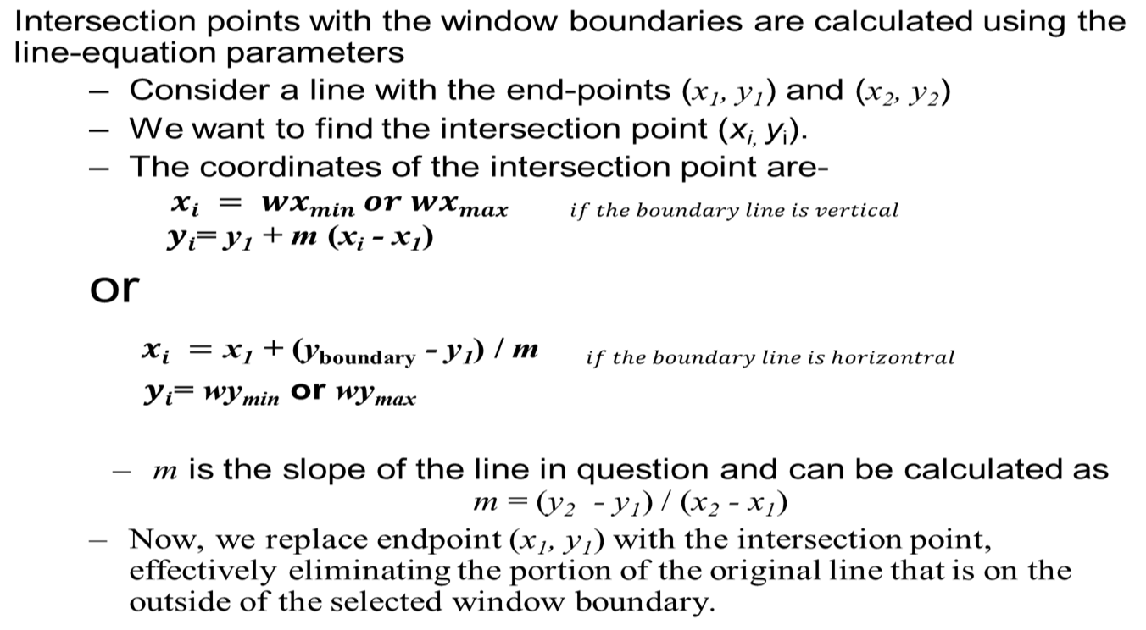
Cohen-Sutherland Clipping Algorithm
Calculating the line intersection

Slide 24
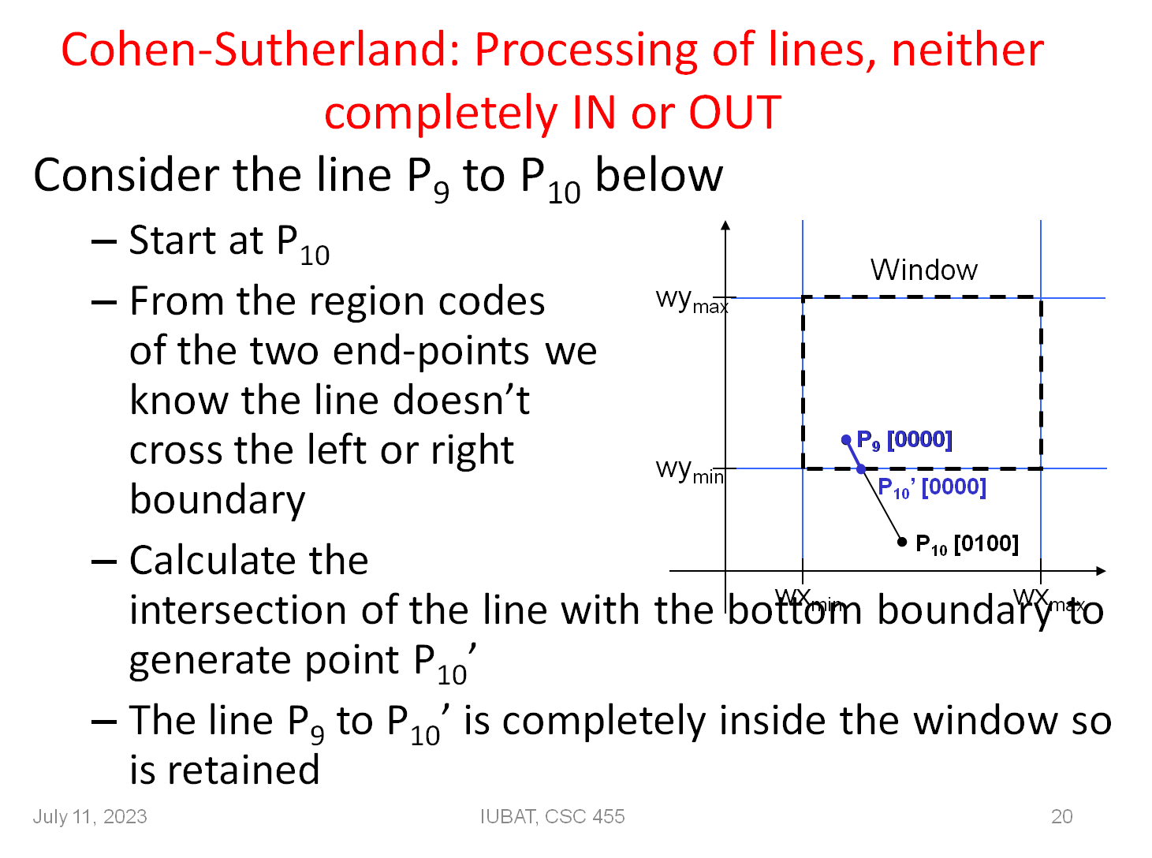
Cohen-Sutherland Clipping Algorithm

Slide 25
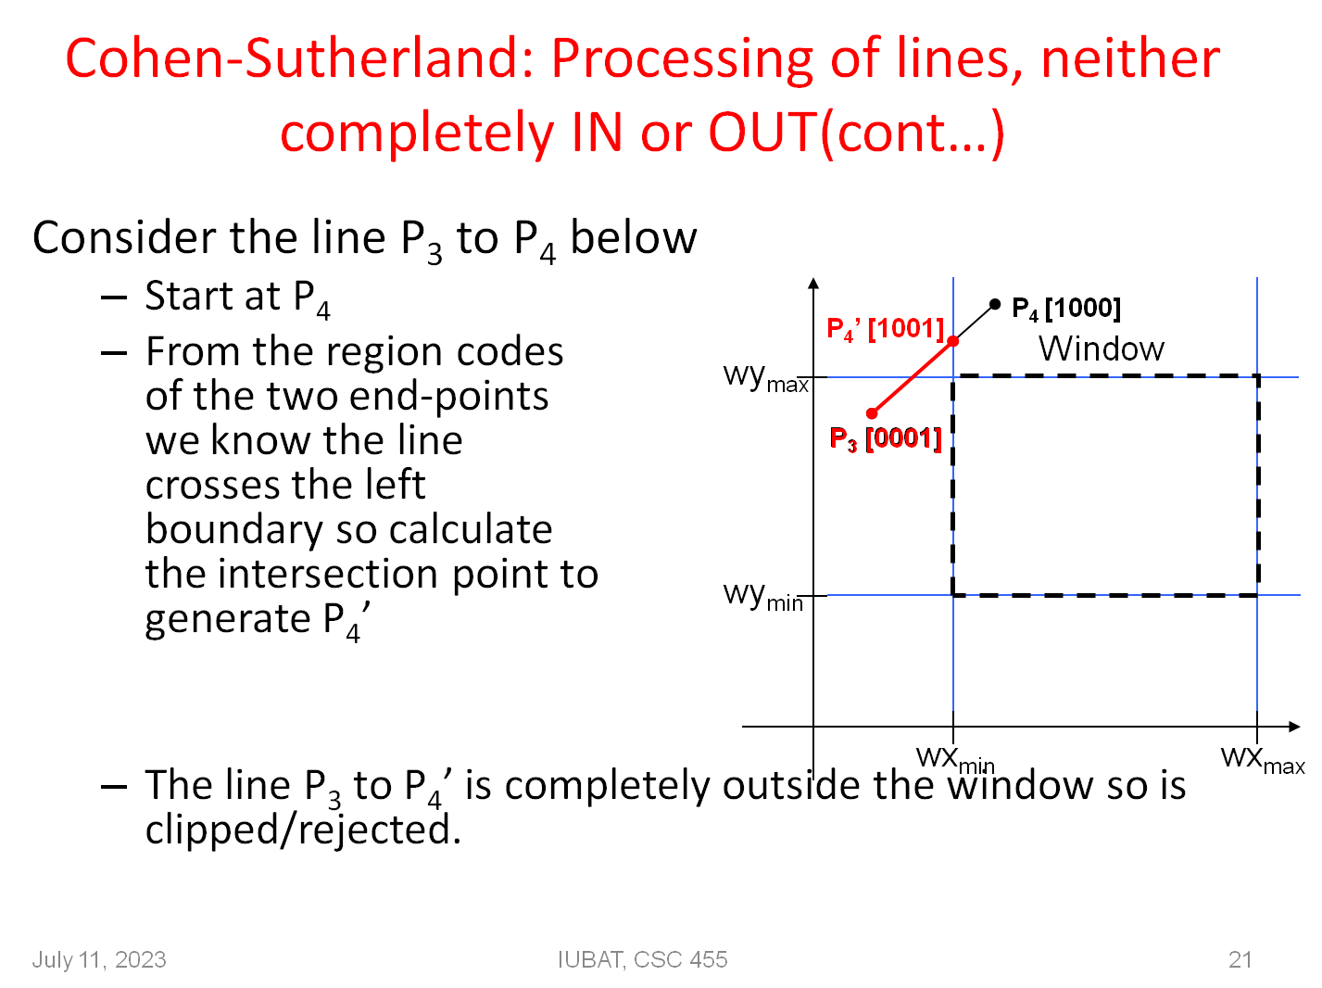
Cohen-Sutherland Clipping Algorithm

Slide 26
Test
Identify the category of the lines A(-1,5) and B(3,8), C(1,3) and D(5,4), E(-2,3) and F(1,3) using the cohen sutherland algorithm with window coordinates (-3,1) and (2,6). Does it require clipping? If yes then find the new coordinates (intersection point) of the clipped line.

